Slide 1





I,
A Universe of particles
...a particle in the universe
Pedro Abreu
abreu@lip.pt
Masterclass in PP
Inkcubeco Science Centre
George, Western Cape
South Africa
30/09/3123
International Particle
Physics Outreach Group

Slide 2
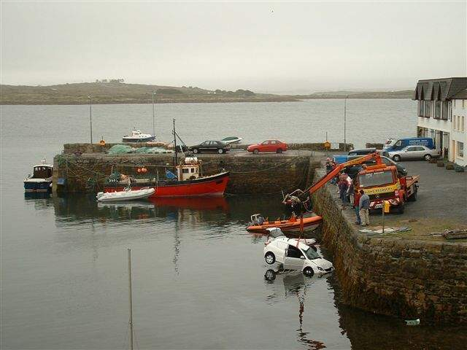
Why study physics?!
preamble:
A Problem:
©2006 Frank Close
2/31

Slide 3
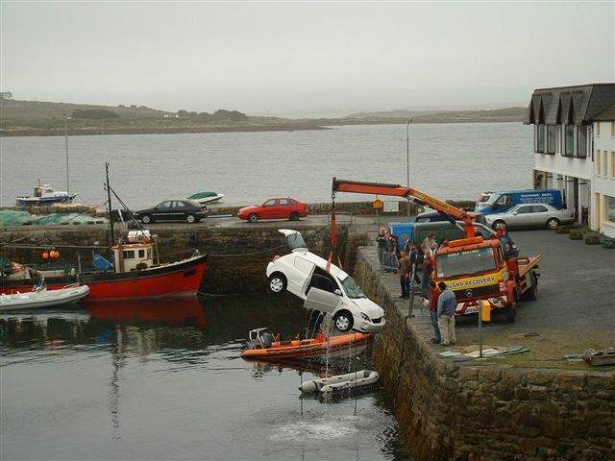
A Solution ?
3/31

Slide 4
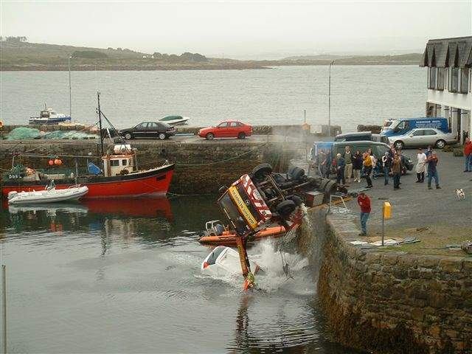
Not quite…
4/31

Slide 5
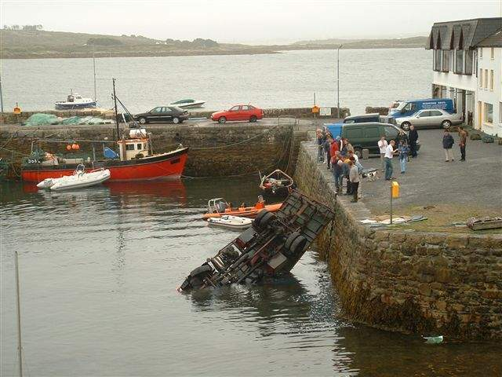
Oops!... Now what?
5/31

Slide 6
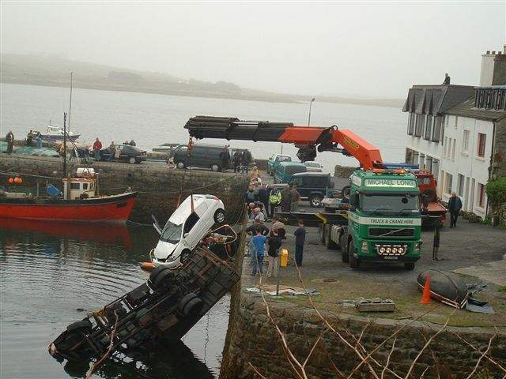
Ok, let’s check this…
6/31

Slide 7

It seems to have worked well…
Message:
Physics has a crucial role on day-to-day activities!
a P > A f
f
A
a
P
7/31

Slide 8
OUR
Universe!
Why?!
Universe!
What?
How?

Slide 9
Universe!
This is NOT our universe!
We are NOT seeing all that exists out there!

Slide 10
(the Higgs field exists EVERYwhere!
if we would see the Higgs field, this would be an image of our Universe)

Slide 11
Universe!
So, what do we “see” in our Universe?

Slide 12
Universe!
Stars (including black holes), Galaxies?
10%
Interstellar/intergalactic gas and dust?
84%
of which…
Hydrogen
74%
Helium
25%
What else?!
Lithium
<1%
Beryllium
trace elements
(Gas and dust only visible in wavelengths different than those of visible light)
Neutrinos?
6%
But...
this is only the part of matter known to us!

Slide 13

Universe!
This is NOT our universe!
THIS? We don’t know!
We know nothing!
We really don’t know anything!
DARK MATTER
We are NOT seeing all that exists out there!
(DARK ENERGY)
68,5%
26,5%
DARK MATTER
Normal matter
5%

Slide 14
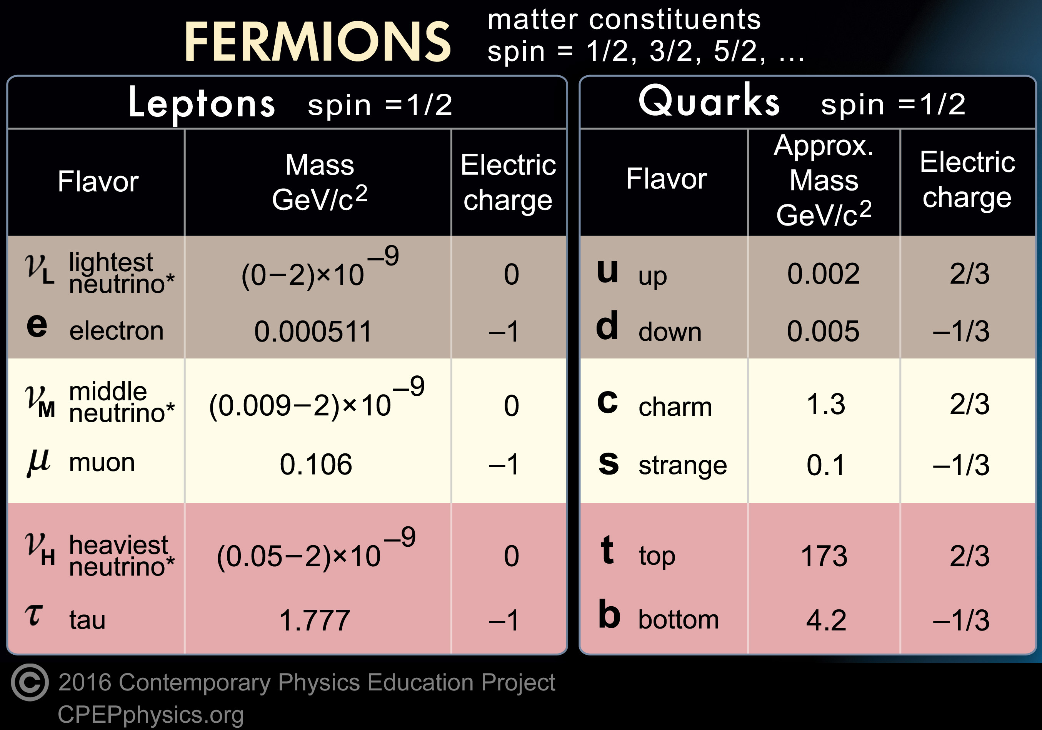
Matter in the Standard Model:
1 GeV/c² = 1.78 x 10⁻²⁷ kg ≈ m(proton) = 0,938 GeV/c²
p={uud}
n={udd}
1956
1964
1897
1964
1962
1974
1937
1964
2001
1995
1975
1977
September 30th
2023
pedro abreu - A Universe of particles, a particle in the universe
14/31

Slide 15
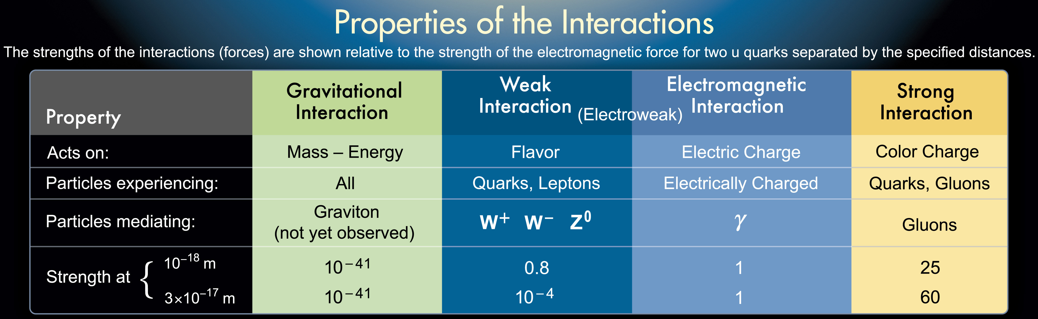
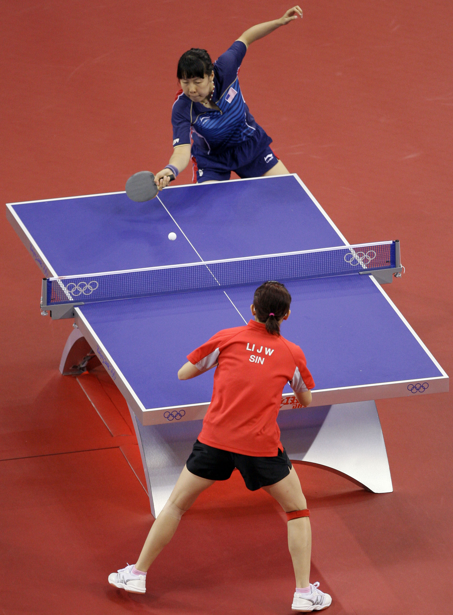

And what about their interactions?
(photon)
Gravity (weight)
Weak Force (Radioactivity $(β)$)
Electromagnetism
(Electricity, magnets,
light)
Strong Force (Cohesion of atomic nuclei)
Gravity out of the Standard Model
Particles of zero mass: range infinite
Very short range: very massive particle!
+Higgs boson
but note:…many interactions incomprehensible! (Human relations, for ex.)
15/31

Slide 16
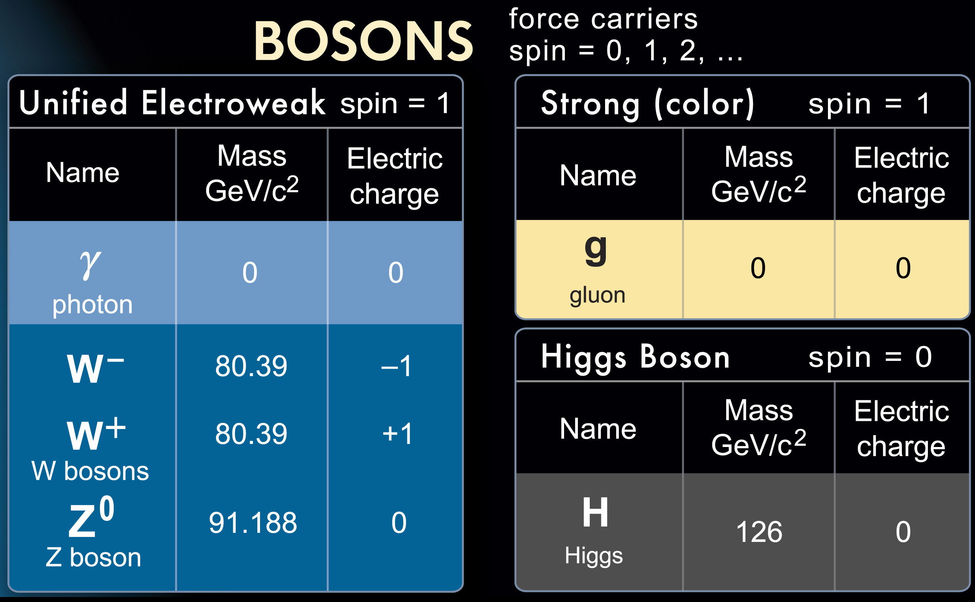
Interactions: exchange of particles!
1900
1979
1905
1979
1983
1983
1983
1983
2012
September 30th
2023
pedro abreu - A Universe of particles, a particle in the universe
16/31

Slide 17
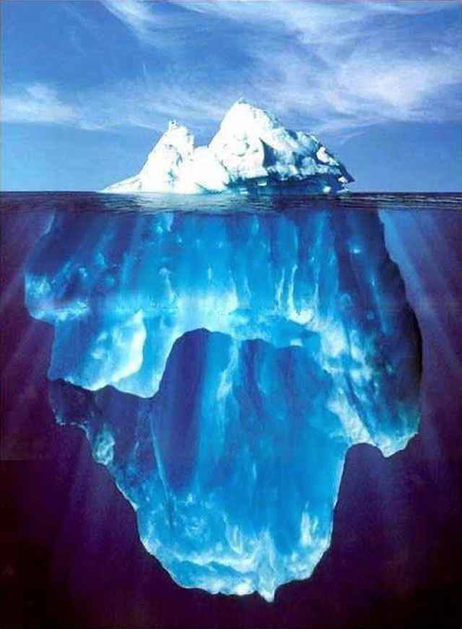
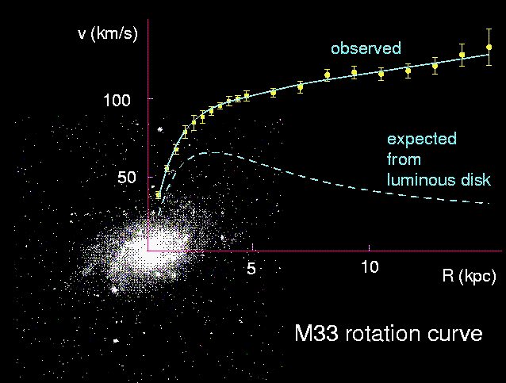
The Dark Matter evidence
SPEED
DISTANCE to the centre
©A.De Angelis
Largest fraction of matter does not shine! What can it be?!
17/31

Slide 18
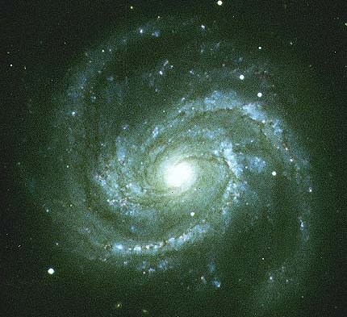
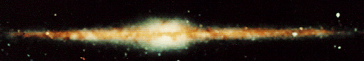
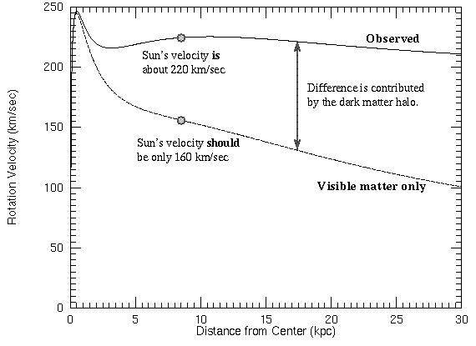
Dark matter even in our galaxy!
M100 ≈ Milky Way
© COBE
Milky Way
©Anglo-Australian Observatory
Spread in the galaxy, not aggregated (not black holes)
No form of matter known!
18/31
Notes:
Tracejado = materia do centro da galaxia (bulge), cheio = materia do disco envolvente (espirais)(Disk), pontilhado = Dark Matter

Slide 19
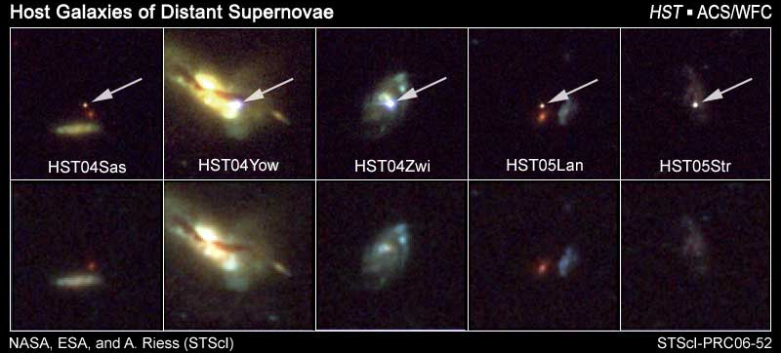
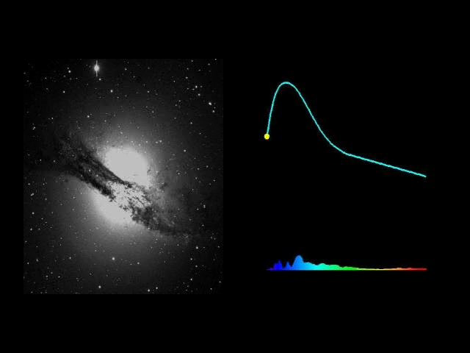
The problem of the expansion of the Universe
Scientists studied distant supernova to measure the evolution of the expansion rate of the Universe (and won the Nobel Prize 2011).
They wanted to know if the rate decreased slowly or quickly (to a big crunch).
Type Ia
19/31

Slide 20
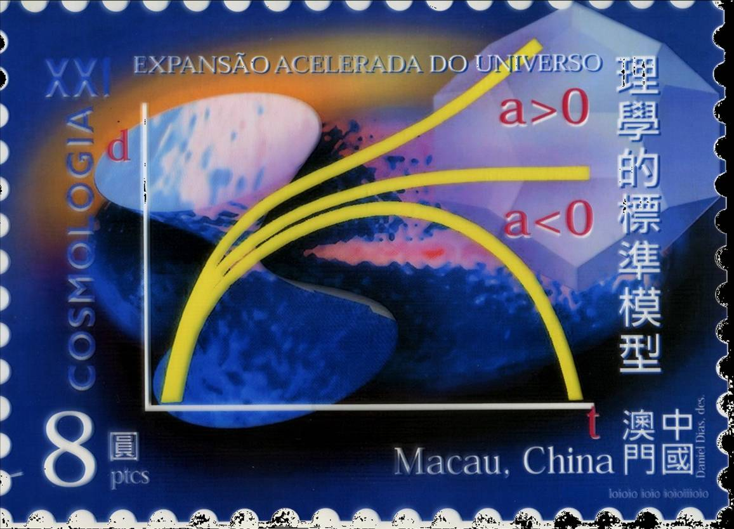
Oops…it is NOT diminishing!
The expansion of
the Universe is
accelerating!!!
Something is
overcoming gravity
Scientists call it ‘Dark Energy ’
20/31

Slide 21
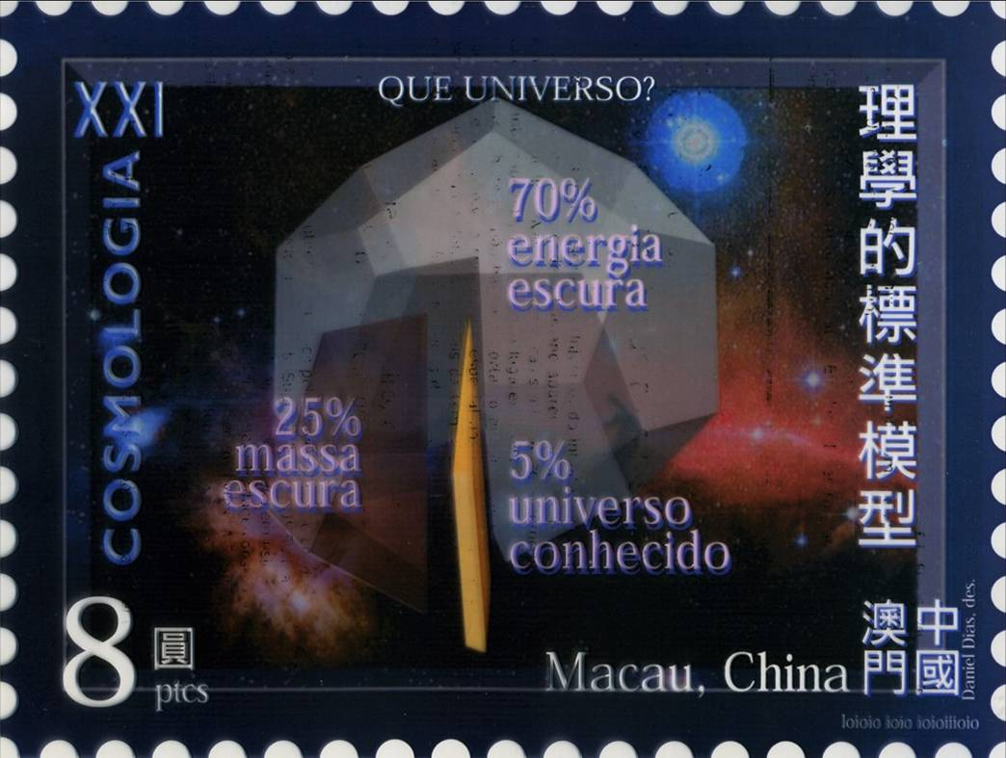
What is the Universe made of ?
Known Matter
5% !!!
??!
?
ÁTOMOS
Dark Matter
26,5 %
Dark Energy
68,5%
??
(Stamp from Macau)
…and why is it so nice to life ?!
21/31

Slide 22
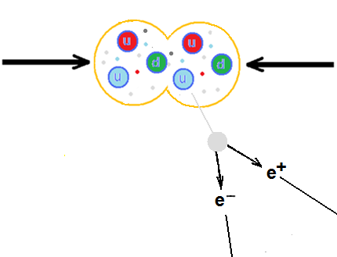








How do we find new particles?
Invariant mass of particle pairs
Particle “X” that decay into two particles
Events with two particles of defined properties are chosen,
and the quantity m(X) is computed from the energy-momentum
of the chosen particles
$$E_{X}=m_{X}c^{2}$$
$$⇒E_{X}^{2}=m_{X}^{2}c^{4}+c^{2}p_{X}^{2}$$
$$m_{X}^{2}=\left(E_{X}^{2}−c^{2}p_{X}^{2}\right)/c^{2}$$
$$E_{X}?p_{X}?$$
$$E_{X}=E_{1}+E_{2}$$
,
$$p_{X }\text{from} p_{1}+p_{2}$$
$$θ$$
$$m_{X}^{2}≅2E_{1}E_{2}(1−f(θ))/c^{4}$$
22/31

Slide 23
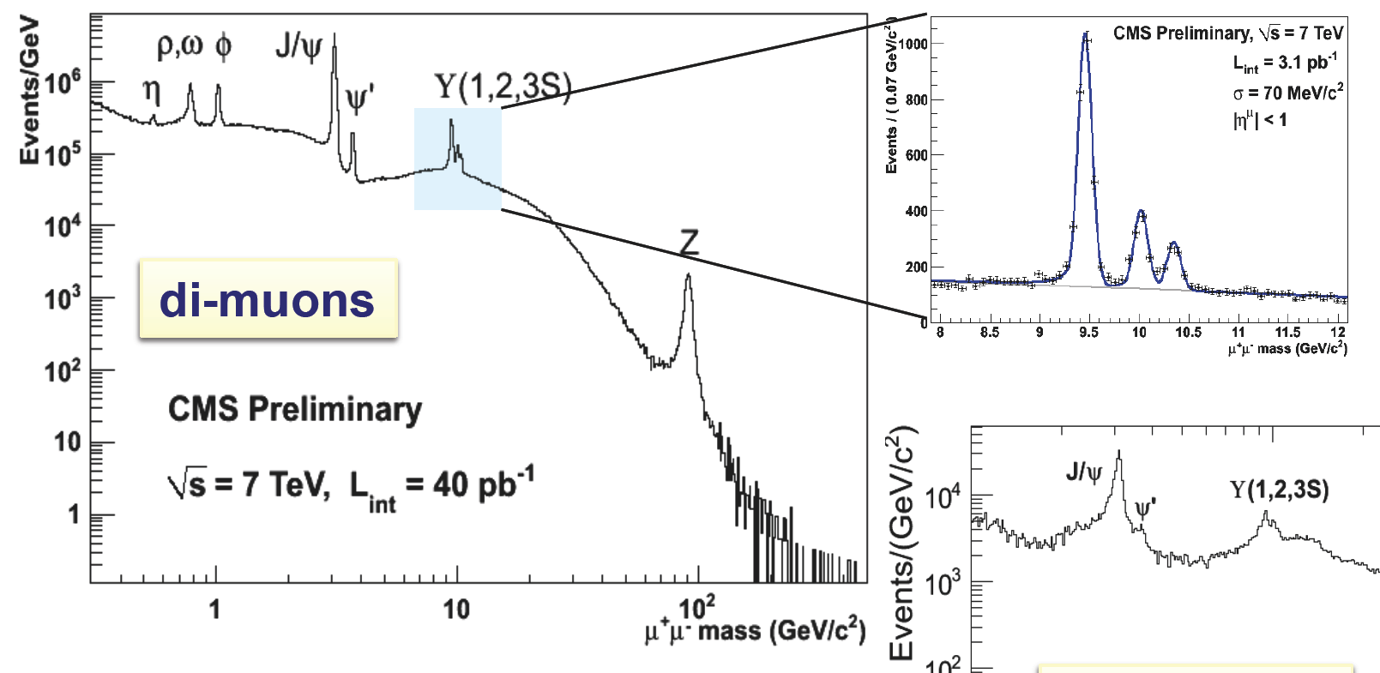
Example:
Mass spectrum(*) of muon pairs (“di-muons”)
Events with two oppositely charged muons
Search for X particles that decay into two muons
  ...and build a distribution of mass values m(X)
(*)Mass spectrum:
Number of events as
function of invariant mass
23/31

Slide 24
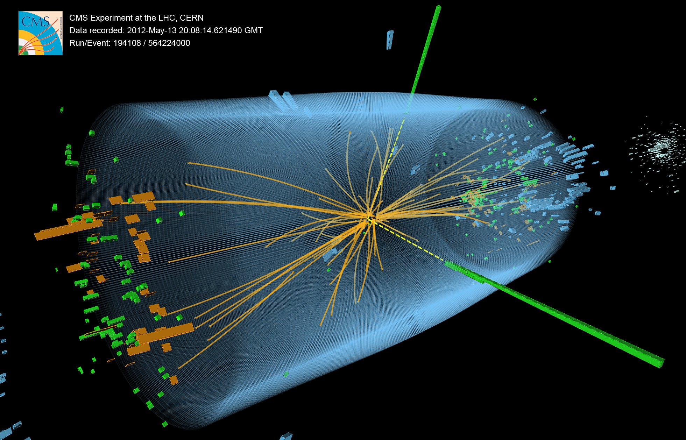
The discovery: H ➔ γγ
(possible decay of the Higgs into 2 photons)

Slide 25
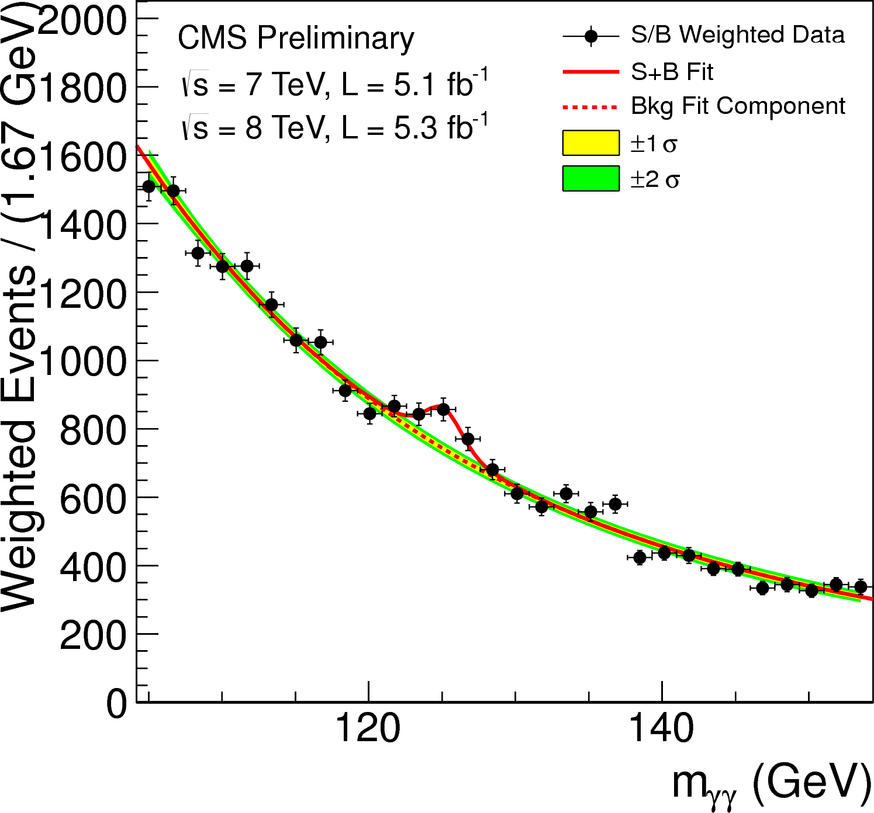
Results from the search for $\text{X}→γγ$:
Invariant mass distribution of 2 photons, m(γγ )
Results from CMS Collaboration
In the invariant mass distribution for γγ, there is an excess of events incompatible with background for masses
~125 GeV/c².
The observation of this new state into 2 photons implies that the new particle is a boson, and that cannot be a particle with “spin 1”.
There is no other fundamental particle with these properties!
25/48
25/31
Notes:
The weighting of events is similar to what is used in the final significance extraction

Slide 26
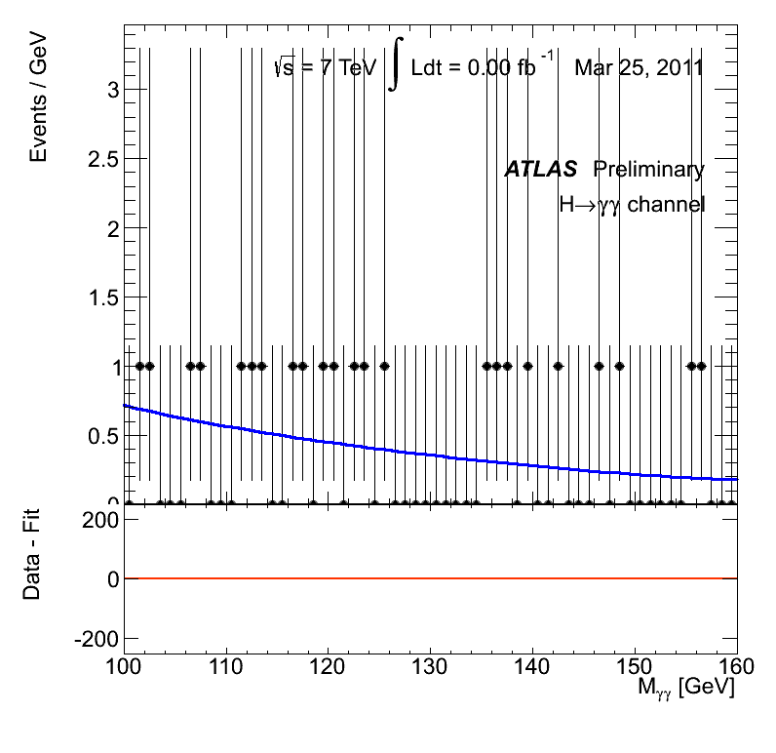
2012: Discovery of the Higgs boson also in ATLAS: $\text{X}→γγ$
26/31
Notes:
The weighting of events is similar to what is used in the final significance extraction

Slide 27
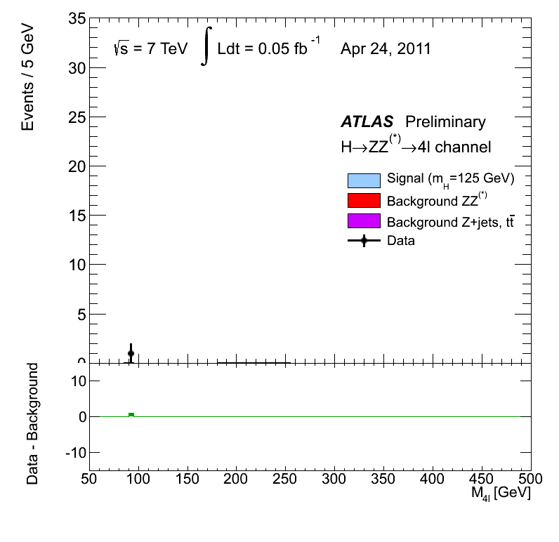
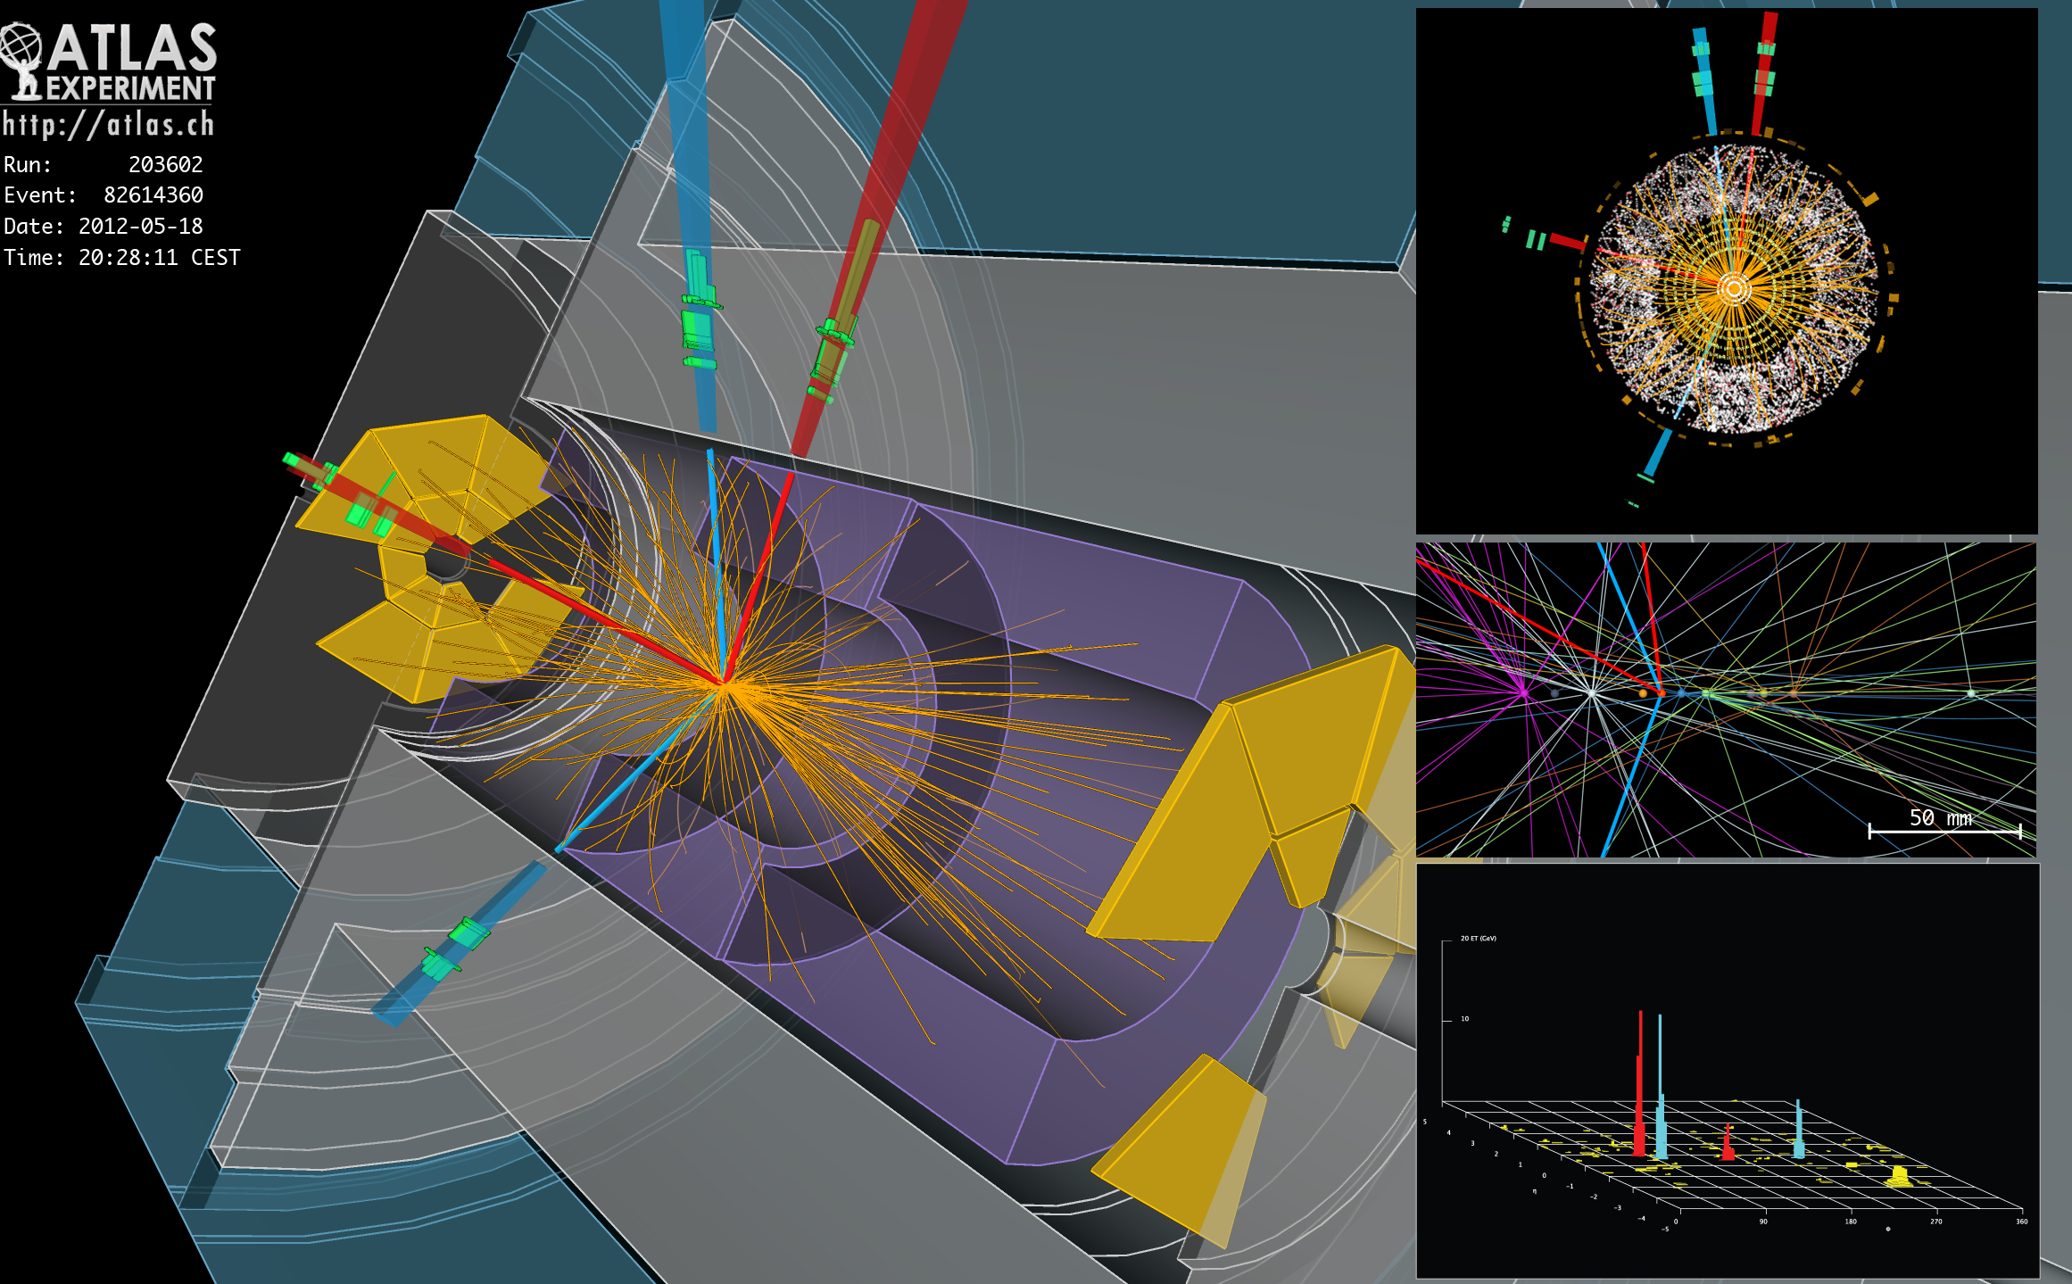
Results from $\text{X}→ZZ^{∗}→l_{1}^{+}l_{1}^{−}l_{2}^{+}l_{2}^{−}(4l)$ :
Invariant mass distribution for 4 leptons, $M(4l)$
(two electron[–positron] pairs, or two muon[-antimuon] pairs, or a pair of electrons and a pair of muons).
27/31
27
Notes:
CMS por baixo do plot de ATLAS

Slide 28
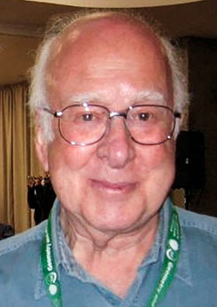
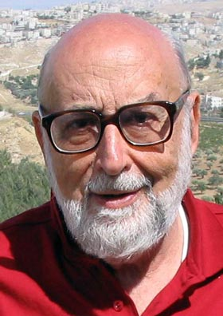
Discovery of the Higgs boson...
...recognized with the Nobel Prize 2013:
François Englert,
belgium,
born 1932,
U. Libre
de Bruxelles
Peter Higgs,
english,
born in
1929,
Univ. of
Edinburgh
"for the theoretical discovery of a mechanism that contributes to our understanding of the origin of mass of subatomic particles, and which recently was confirmed through the discovery of the predicted fundamental particle, by the ATLAS and CMS experiments at CERN's Large Hadron Collider"
28/31

Slide 29
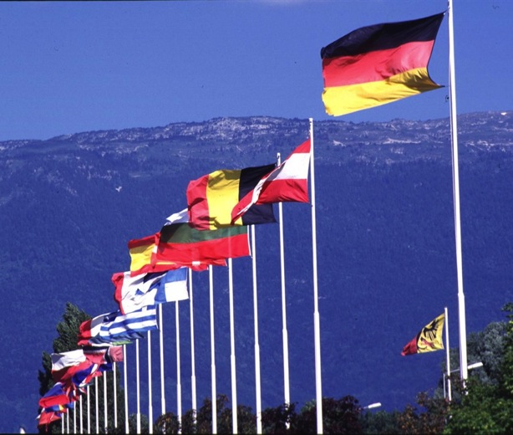
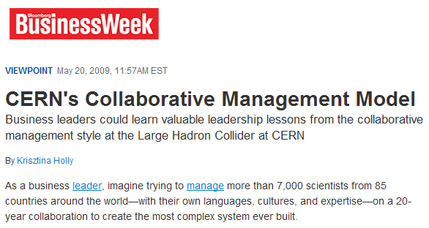
It’s a collaborative
effort!
29/31

Slide 30

The Higgs field and the Higgs boson
ESTE SLIDE É A ANIMAÇÃO DO HIGGS DO DON LINCOLN
BASEADA NA IDEIA DO DAVID MILLER (INSERIR DO
POWERPOINT EXTERIOR)
30/31
Notes:
30

Slide 31
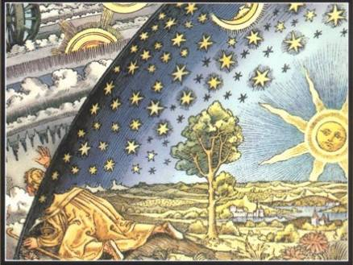
Thank you for your patience
Albert Einstein [P.N.1921]: (With knowledge...)
“We can look to the Universe as if there were no miracles.
But we can also look to the Universe as if everything is a miracle!”
31/31

